Slide 1
Vietnam National University Ho Chi Minh City, University of Information Technology
INTRODUCTION TO IMAGE PROCESSING
AND COMPUTER VISION
Ho Chi Minh City, 4/2024

Slide 2
Outline
1
Introduction
2
Fundamental and Related works
3
Features Extraction Techniques
4
Pre-processing Techniques
5
Conclusion and Future works

Slide 3
1. Introduction: Motivation
Automate Visual Tasks: Reduce human effort in repetitive visual tasks.
Enhance Decision-Making: Provide accurate visual data for informed decisions.
Improve Safety: Enable real-time monitoring and hazard detection.
Innovate Technology: Drive advancements in AI and machine learning.

Slide 4
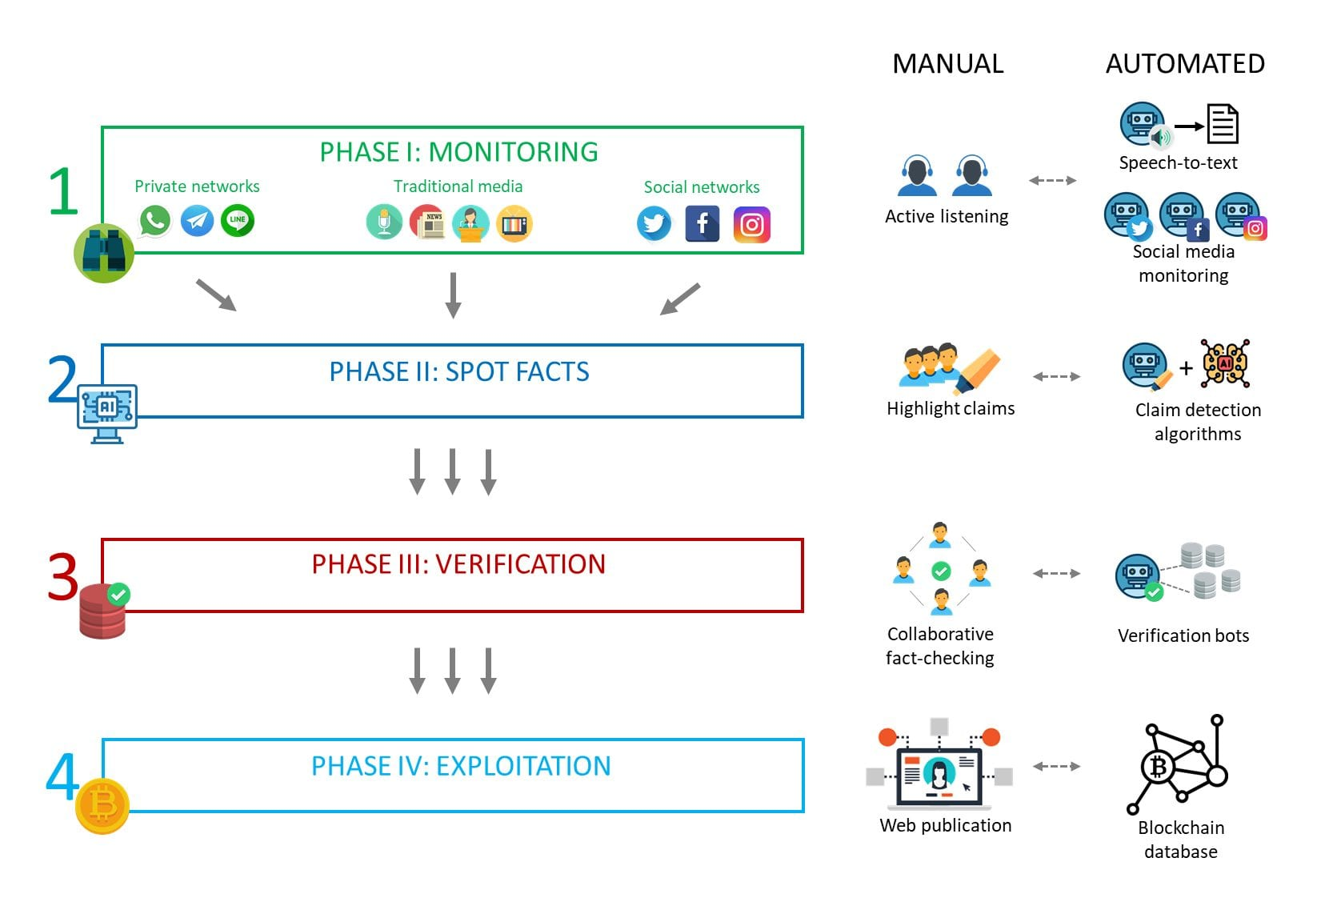
1. Introduction: Objective
Object Recognition: Identify and classify objects in images.
Image Segmentation: Divide images into meaningful parts.
Scene Understanding: Interpret and analyze complex scenes.
Feature Extraction: Isolate essential characteristics from visual data.

Slide 5

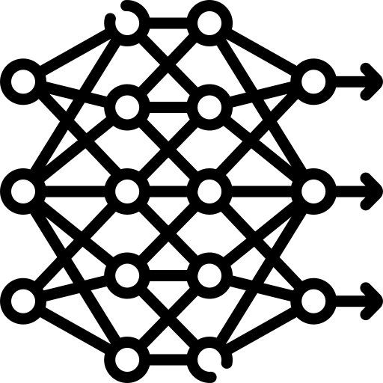


2. Fundamental of FR: Task Definition
The human brain has innate organizing tendencies that “structure individual elements, shapes or forms into a coherent, organized whole,” especially when processing visual information. - Gestalt
Image data
Features Extraction
Modelling
Predictive Model

Slide 6
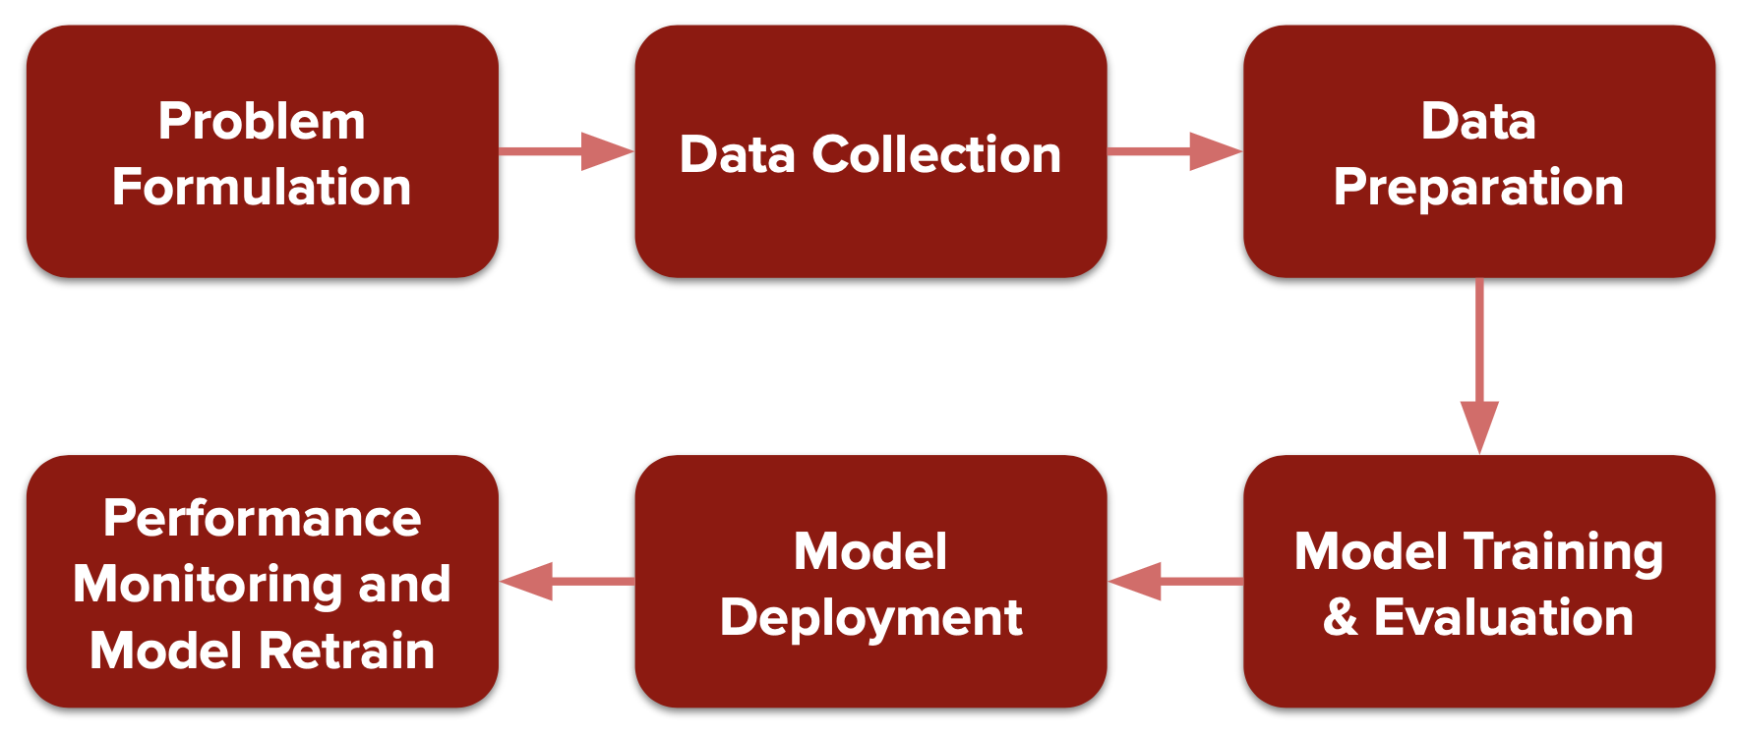
2. Fundamental of FR: Task Definition

Slide 7
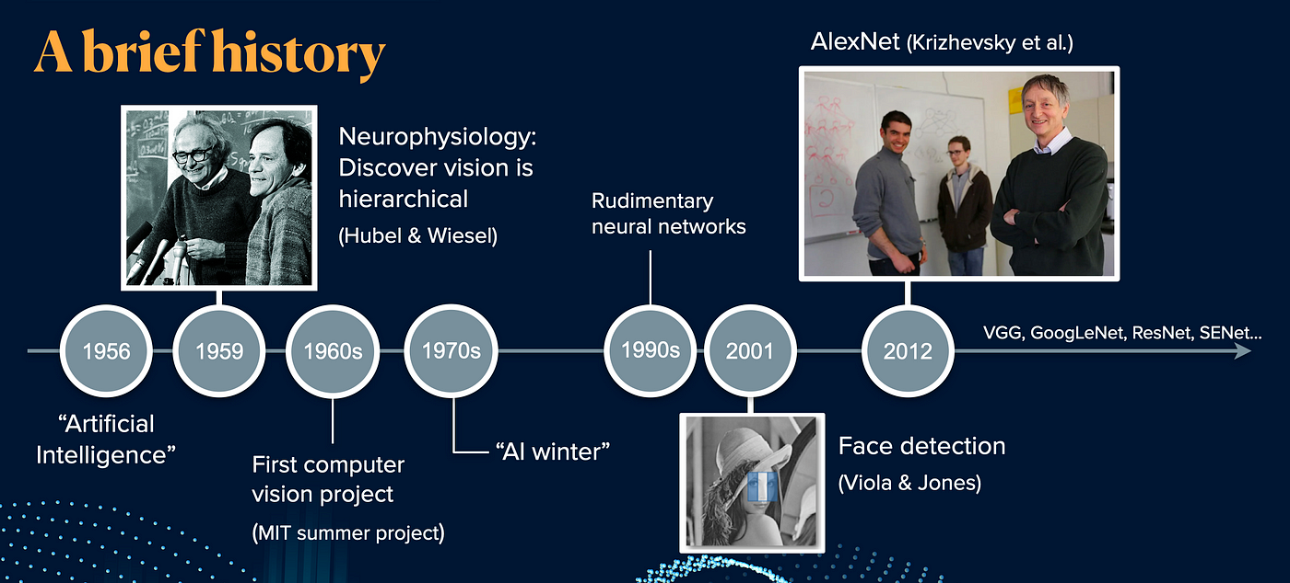
2. Fundamental of FR: Related works
Notes:
Hierarchical Models of the Visual System - https://link.springer.com/referenceworkentry/10.1007/978-1-4614-7320-6_345-1

Slide 8
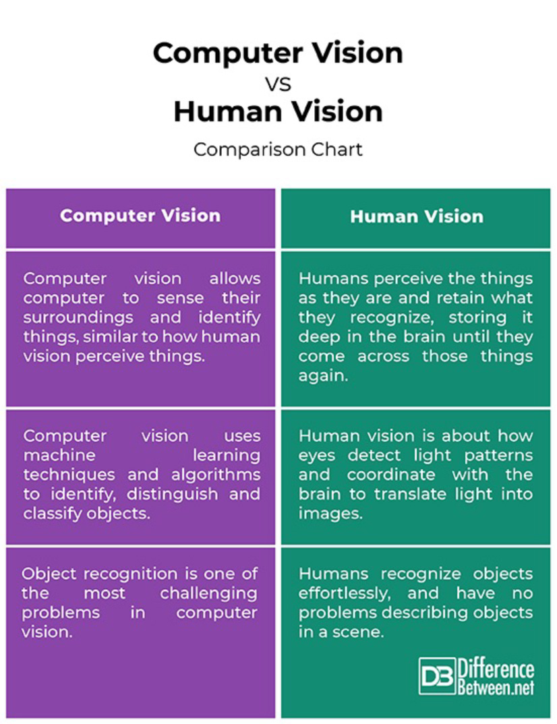
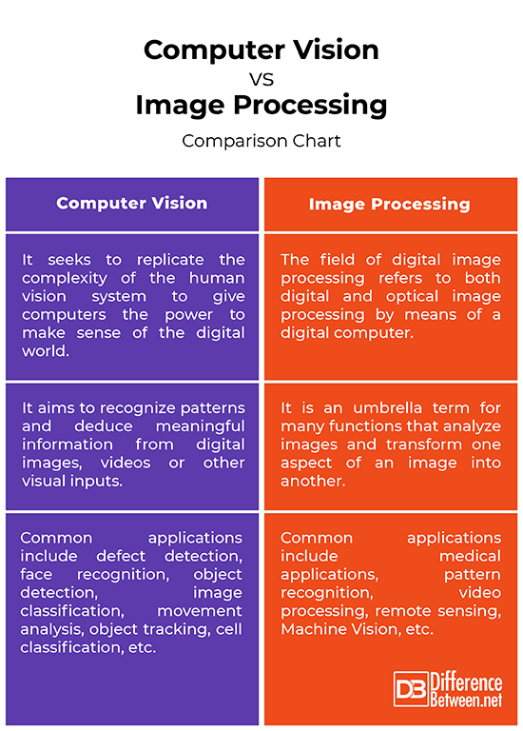

Slide 9
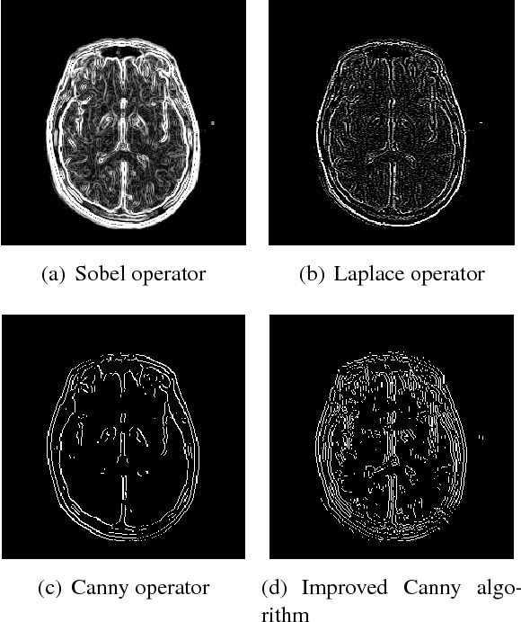
3. Features Extraction Techniques
3.1 Edge Detection
Detects sharp changes in intensity to find edges in images. Common algorithms include the Sobel, Canny, and Prewitt operators.
Use Case: Image segmentation, object detection, and boundary recognition.
Gradient-based Methods: calculate the image intensity gradient to identify areas of rapid change.
Laplacian-based Methods: measures the second derivative of the image intensity and detects areas of zero crossing.
Canny Edge Detection: a multi-step algorithm that provides accurate and reliable edge detection. It involves smoothing the image, calculating gradients, performing non-maximum suppression, and applying hysteresis thresholding to determine the final edges.
Notes:
Ví dụ, nó có thể được sử dụng trong hình ảnh y tế để phác thảo các cấu trúc giải phẫu.
===
Pros
Structural Information: Edge detection provides valuable structural information about the objects and boundaries within an image.
Feature Extraction: Other high-level features can be extracted by identifying edges, such as corners and contours.
Object Segmentation: Edges can help to segment objects or regions within an image, enabling subsequent analysis or manipulation.
Cons
Noise Sensitivity: Edge detection can be sensitive to noise, leading to false positives or incomplete edge detection in noisy images.
Edge Fragmentation: In some cases, edges may be fragmented or discontinuous, especially when the image contains complex textures or low-contrast regions.
Parameter Tuning: Some edge detection methods require fine-tuning parameters to achieve optimal results, making them more user-dependent.

Slide 10
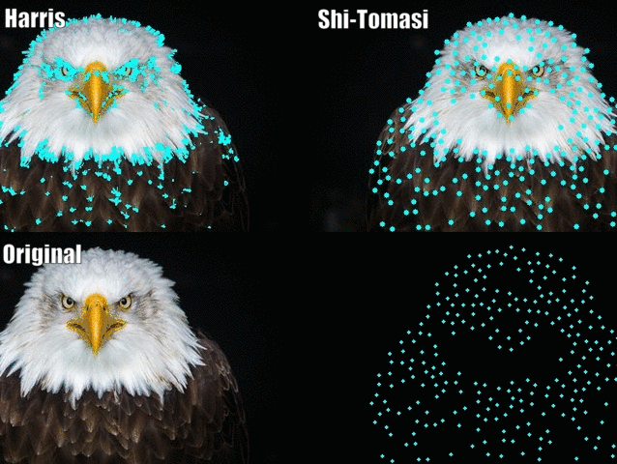
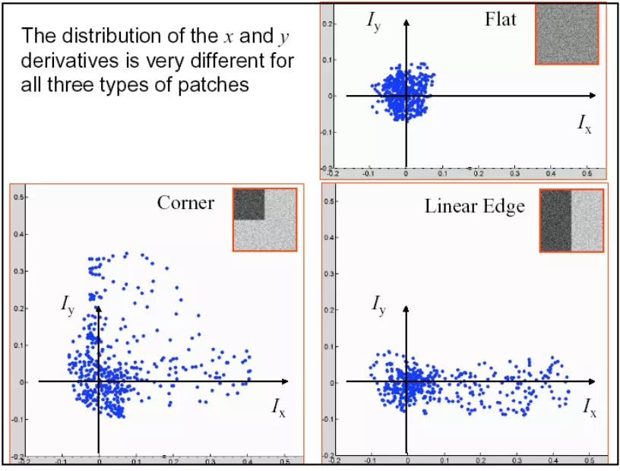
3. Features Extraction Techniques
3.2 Corner Detection
Identifies points where two edges meet, known as corners. Harris Corner Detector and Shi-Tomasi methods are popular.
Use Case: Useful in motion detection, image matching, and video tracking.
Harris Corner Detector: analyzing the local changes in intensity with respect to shifts in a window. A high response indicates a corner, while a low response indicates an edge or flat region.
Shi-Tomasi Corner Detector: An improvement over the Harris Corner Detector, this method selects corners based on the minimum eigenvalue of the second-moment matrix. It is more robust in identifying strong corners and is often used in applications like the Kanade-Lucas-Tomasi (KLT) tracker.
Notes:
Ví dụ: trong các ứng dụng thực tế tăng cường để theo dõi chuyển động và phủ hình ảnh kỹ thuật số một cách chính xác.
====
https://viblo.asia/p/corner-detection-voi-opencv-eW65Gv6YlDO
https://viblo.asia/p/ung-dung-thuat-toan-harris-corner-detector-trong-bai-toan-noi-anh-phan-i-ByEZkyME5Q0

Slide 11
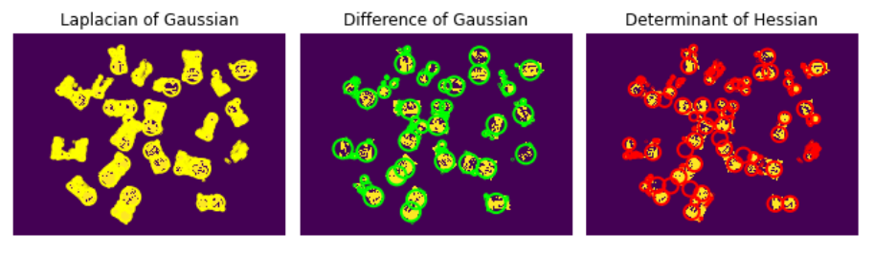
3. Features Extraction Techniques
3.3 Blob Detection
Finds regions or 'blobs' in an image that differ in properties like brightness or color from the surrounding background.
Use Case: counting objects or cells in biology, detecting and tracking objects in surveillance.
Laplacian of Gaussian (LoG): smoothing the image with a Gaussian filter and then applying the Laplacian operator.
Difference of Gaussian (DoG): subtracting two Gaussian-smoothed images with different standard deviations. DoG is computationally efficient and widely used in applications like the Scale-Invariant Feature Transform (SIFT).
Determinant of Hessian (DoH): calculating the Hessian matrix for each pixel in the image and then computing the determinant of this matrix.
Notes:
Ví dụ: trong các ứng dụng thực tế tăng cường để theo dõi chuyển động và phủ hình ảnh kỹ thuật số một cách chính xác.
====

Slide 12
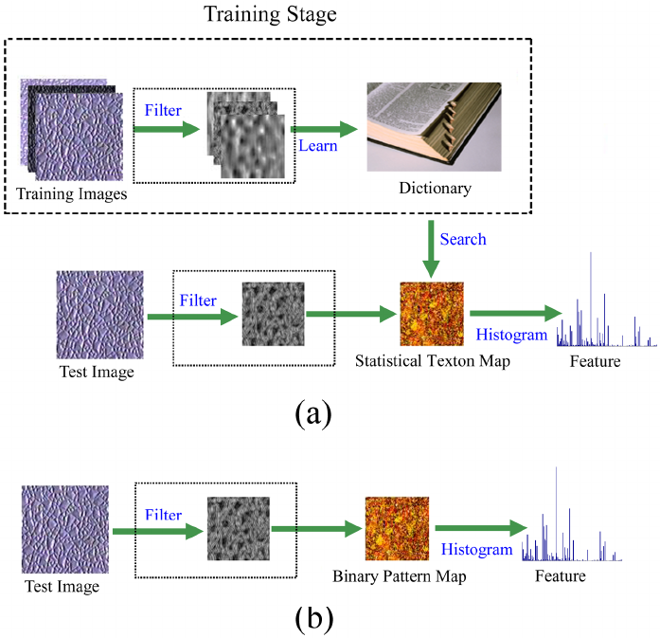
3. Features Extraction Techniques
3.4 Textual Analysis
Analyzes the spatial arrangement of pixel intensities in an image to identify patterns, textures, and structural properties. Common methods include statistical, structural, and model-based approaches.
Use Case: Image classification, pattern recognition, and material identification.
Statistical Methods: Gray Level Co-occurrence Matrix (GLCM), Local Binary Pattern, HOG.
Structural Methods: Voronoi Tessellation, Fractal Analysis, Morphological Analysis.
Model-based Methods: Markov Random Fields, Gabor Filters, Wavelet Transform.
Notes:
Statistical Methods: These methods characterize the texture by analyzing the statistical properties of pixel intensities. Common techniques include:
Gray Level Co-occurrence Matrix (GLCM): This method computes the frequency of pixel pairs with specific values and spatial relationships. From the GLCM, various texture features such as contrast, correlation, energy, and homogeneity can be derived.
Local Binary Patterns (LBP): This technique labels the pixels of an image by thresholding the neighborhood of each pixel and considering the result as a binary number. LBP is efficient and robust for texture classification.
Histogram of Oriented Gradients (HOG): This method counts occurrences of gradient orientation in localized portions of an image. It is widely used in object detection and image descriptor extraction.
Structural Methods: These methods describe texture using the arrangement and relationship of basic primitives or texture elements (texels). Common techniques include:
Voronoi Tessellation: This method partitions the image into regions based on proximity to a set of points, creating a tessellation that can be analyzed for texture patterns.
Fractal Analysis: This technique models textures as fractals and uses fractal dimensions to describe the complexity and self-similarity of textures.
Morphological Analysis: This method involves using morphological operations (e.g., dilation, erosion) to analyze the structure and arrangement of texture elements.
Model-based Methods: These methods use mathematical models to represent textures and extract features. Common techniques include:
Markov Random Fields (MRF): This probabilistic model represents the spatial dependencies of pixel intensities. Texture features are extracted by estimating the model parameters.
Gabor Filters: These linear filters are used to analyze the frequency content of textures. By applying a set of Gabor filters with different orientations and scales, texture features can be extracted based on the filter responses.
Wavelet Transform: This technique decomposes an image into different frequency components using wavelets. Texture features are derived from the wavelet coefficients at various scales and orientations.

Slide 13
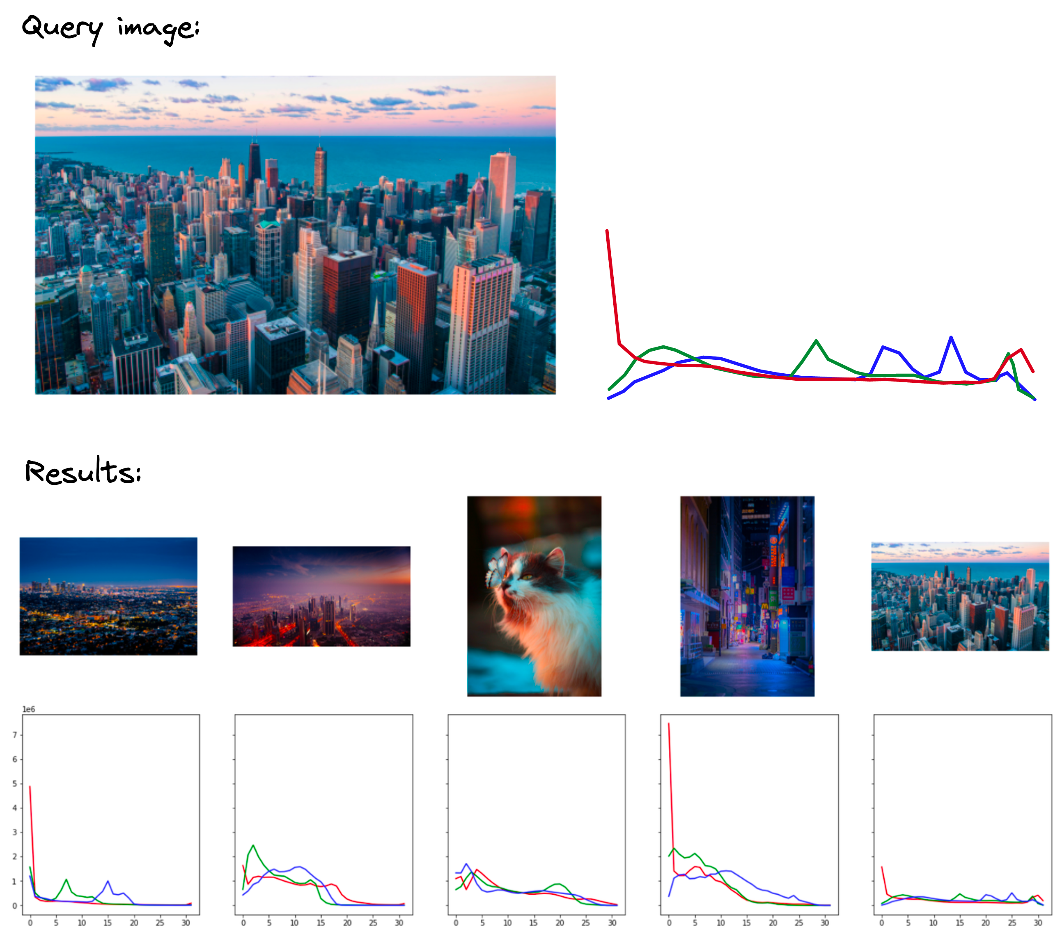
3. Features Extraction Techniques
3.5 Color Histograms
Analyzes the distribution and proportion of colors in an image. It represents an image in terms of its color content.
Use Case: Image retrieval, image classification, and image enhancement.
Basic Concept: A color histogram is a graphical representation of the distribution of colors in an image.
Each pixel in an image is represented by a color value, typically in the RGB color space.
The histogram counts the number of pixels for each color value, allowing for a visual representation of the color distribution.
Notes:
Advantages and Limitations:
Advantages: Color histograms are simple to compute and provide a compact representation of the color distribution in an image. They are effective for tasks where color is a significant feature.
Limitations: Color histograms do not capture spatial information about the colors in an image. This means that two images with similar color distributions but different spatial arrangements of colors may have similar histograms. Additionally, color histograms can be sensitive to changes in lighting and color variations
.

Slide 14
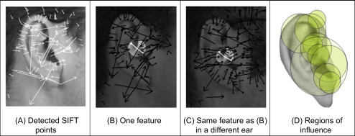
3. Features Extraction Techniques
3.6 Scale-Invariant Feature Transform (SIFT)
Detects and describes local features in images that are invariant to scale, rotation, and partially invariant to affine transformations.
Use Case: Essential in object recognition, robotic mapping and navigation, and 3D modeling.
Key Steps in the SIFT Algorithm:
Scale-space Extrema Detection;
Keypoint Localization;
Orientation Assignment;
Keypoint Descriptor: typically a 128-dimensional vector that is invariant to changes in illumination and viewpoint
Notes:
1.Key Steps in the SIFT Algorithm: Scale-space Extrema Detection:
The first step involves searching for stable keypoint locations over multiple scales using a Difference of Gaussian (DoG) function. This is achieved by constructing a scale-space representation of the image through Gaussian blurring and then subtracting adjacent blurred images.
Keypoints are identified as local maxima and minima of the DoG that remain stable across different scales.
2.Keypoint Localization:
Once potential keypoints are identified, they are refined to sub-pixel accuracy. This involves fitting a quadratic function to the local sample points to determine the exact location, scale, and contrast of each keypoint.
Keypoints with low contrast or poorly localized along edges are discarded to improve robustness.
3.Orientation Assignment:
Each keypoint is assigned one or more orientations based on the local gradient directions of the image. This step ensures that the descriptors are invariant to image rotation.
A histogram of gradient directions is computed in the neighborhood of the keypoint, and the peak(s) of this histogram determine the keypoint orientation(s).
4.Keypoint Descriptor:
A region around each keypoint is divided into a grid of smaller regions, and a local gradient histogram is computed for each sub-region. The concatenation of these histograms forms the keypoint descriptor.
The descriptor is typically a 128-dimensional vector that is invariant to changes in illumination and viewpoint.

Slide 15
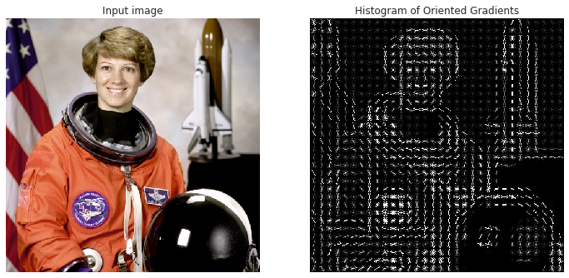
3. Features Extraction Techniques
3.7 Histogram of Oriented Gradients (HOG)
Extracts features from an image by counting occurrences of gradient orientation in localized portions of the image.
Use Case: Object detection, image classification, and human detection.
Key Steps in the SIFT Algorithm:
Gradient Computation
Orientation Binning
Descriptor Blocks
HOG Descriptor
Notes:
Key Steps in the HOG Algorithm: Gradient Computation:
The first step involves computing the gradient of the image. This is typically done using filters like the Sobel operator to calculate the gradients in the x and y directions. The gradient magnitude and orientation are then derived from these gradients
Orientation Binning:
The image is divided into small, connected regions called cells (e.g., 8x8 pixels). For each cell, a histogram of gradient directions is created. The gradient orientations are quantized into a fixed number of bins (e.g., 9 bins for angles ranging from 0 to 180 degrees)
Each pixel within a cell contributes to the histogram based on its gradient magnitude and orientation. This step captures the local shape information within the cell
Descriptor Blocks:
To account for changes in illumination and contrast, the histograms are normalized. This is done by grouping cells into larger, overlapping blocks (e.g., 2x2 cells per block). The histograms within each block are concatenated and normalized to form the block descriptor.
The normalization helps in making the descriptor invariant to changes in lighting and contrast.
HOG Descriptor:
The final HOG descriptor is a concatenated vector of all the normalized block histograms. This descriptor captures the distribution of gradient orientations over the entire image or a region of interest
The resulting feature vector is used for further processing, such as feeding into a machine learning classifier for object detection.
Advantages and Limitations:
Advantages: HOG is robust to changes in illumination and small deformations. It provides a dense and rich representation of the local shape information in an image, making it effective for object detection tasks.
Limitations: HOG can be computationally intensive, especially for large images. It also requires careful tuning of parameters like cell size, block size, and the number of orientation bins to achieve optimal performance

Slide 16
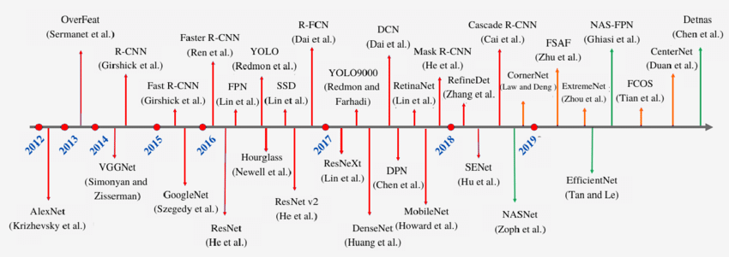
3. Proposed method for Forward Regression
3.8 Deep Learning-Based Features
Automatically learns and extracts features from raw data using deep neural networks.

Slide 17
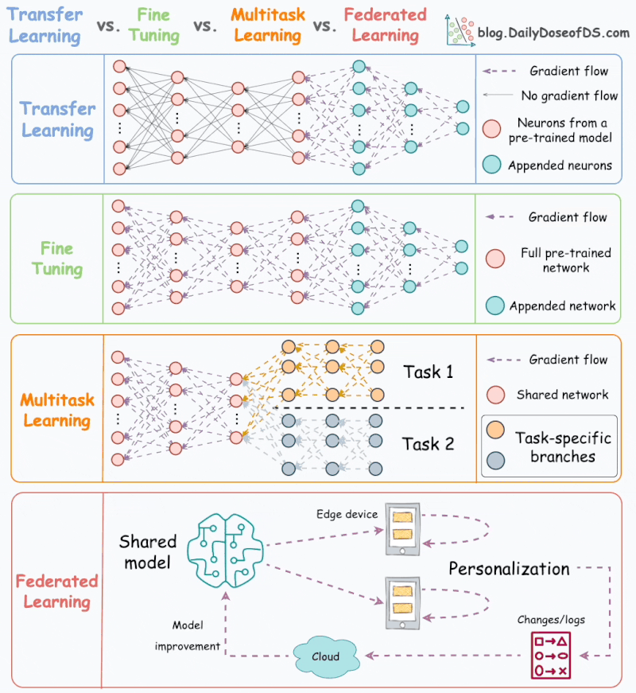

Slide 18
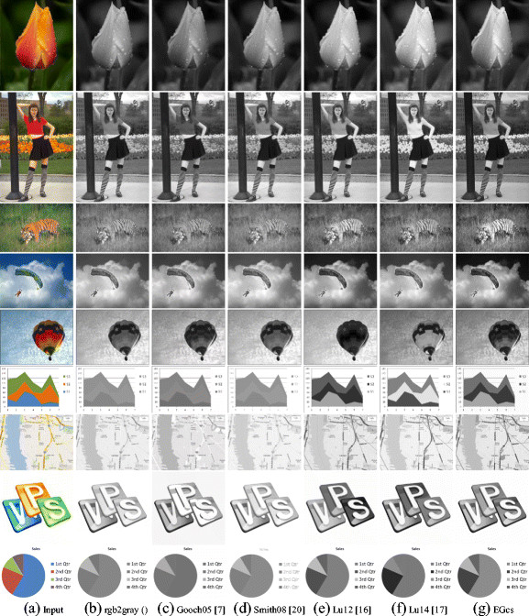
4. Pre-processing Techniques
4.1 Grayscale Conversion
Converts a color image into shades of gray, reducing the complexity of the image.
Use Case: Often used as a preliminary step in many image processing tasks to simplify the analysis, such as in object detection or text recognition.

Slide 19
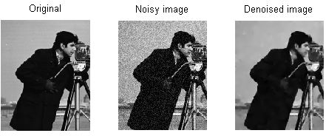
4. Pre-processing Techniques
4.2 Histogram Equalization
Removes random variations in the image, known as noise. Common techniques include Gaussian blur, median filtering, and bilateral filtering.
Use Case: Essential in enhancing image quality for medical imaging, satellite imagery, and photography.

Slide 20
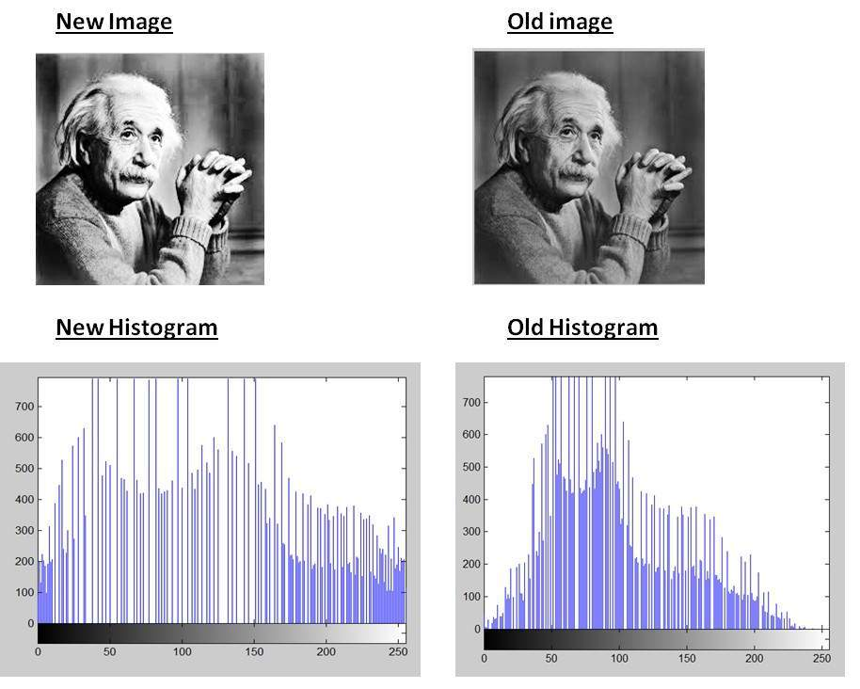
4. Pre-processing Techniques
4.3 Histogram Equalization
Adjusts the contrast of an image by modifying the intensity distribution. This is done by spreading out the most frequent intensity values.
Use Case: Useful in improving the visibility of features in dark regions of an image, like enhancing details in X-ray images

Slide 21
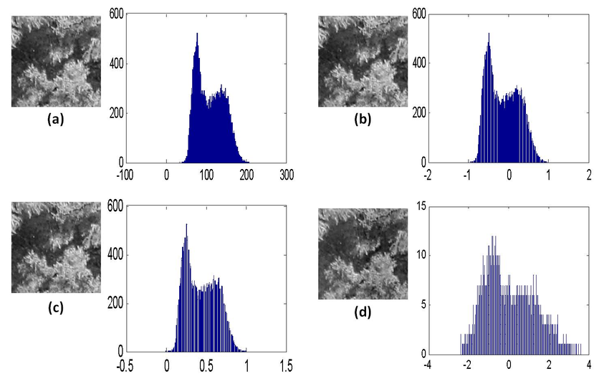
4. Pre-processing Techniques
4.4 Normalization
Scales pixel values to a standard range, often 0 to 1 or -1 to 1. This can be done globally or based on local neighborhoods.
Use Case: Crucial in machine learning and deep learning applications to standardize input data for consistent model training.

Slide 22
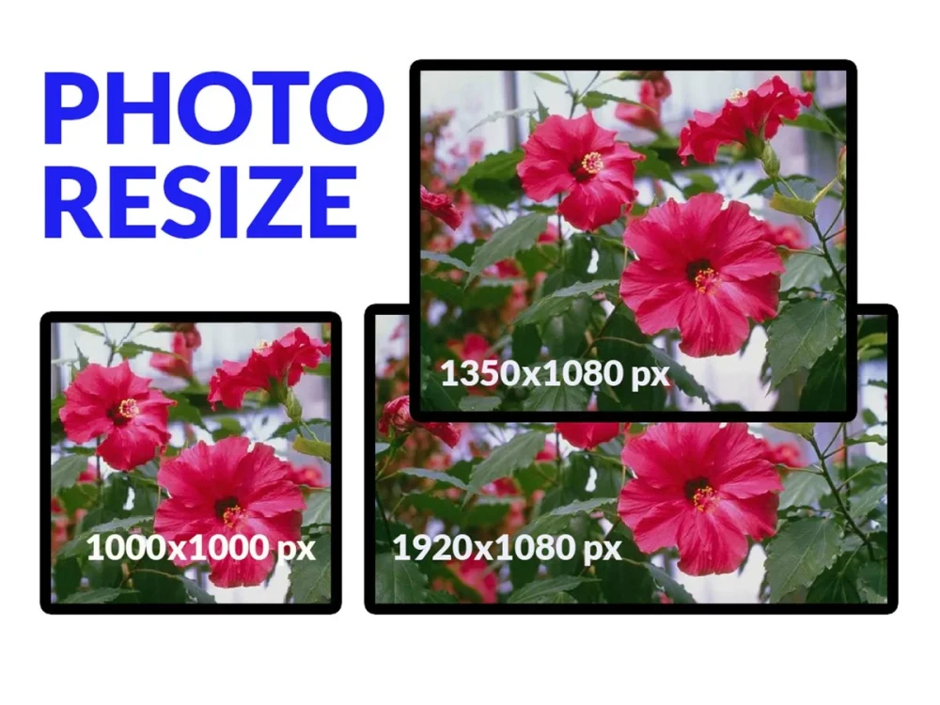
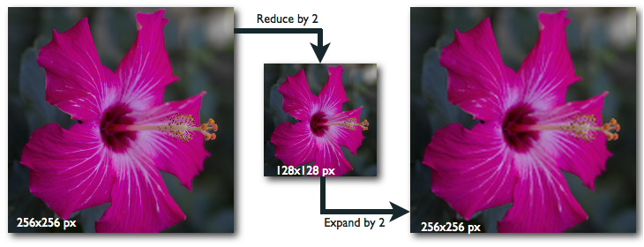
4. Pre-processing Techniques
4.5 Resizing and Rescaling
Alters the size of the image, either by resizing (changing the number of pixels) or rescaling (changing the scale but not the content).
Use Case: Important for preparing images for input into neural networks where input dimensions are fixed.
Notes:
Both involves in changing the shape of the image. In resizing we are changing height and width as necessary. While, in rescaling we have to maintain the width to height ratio. Hence, rescaling do not cause distortion or skewing.

Slide 23
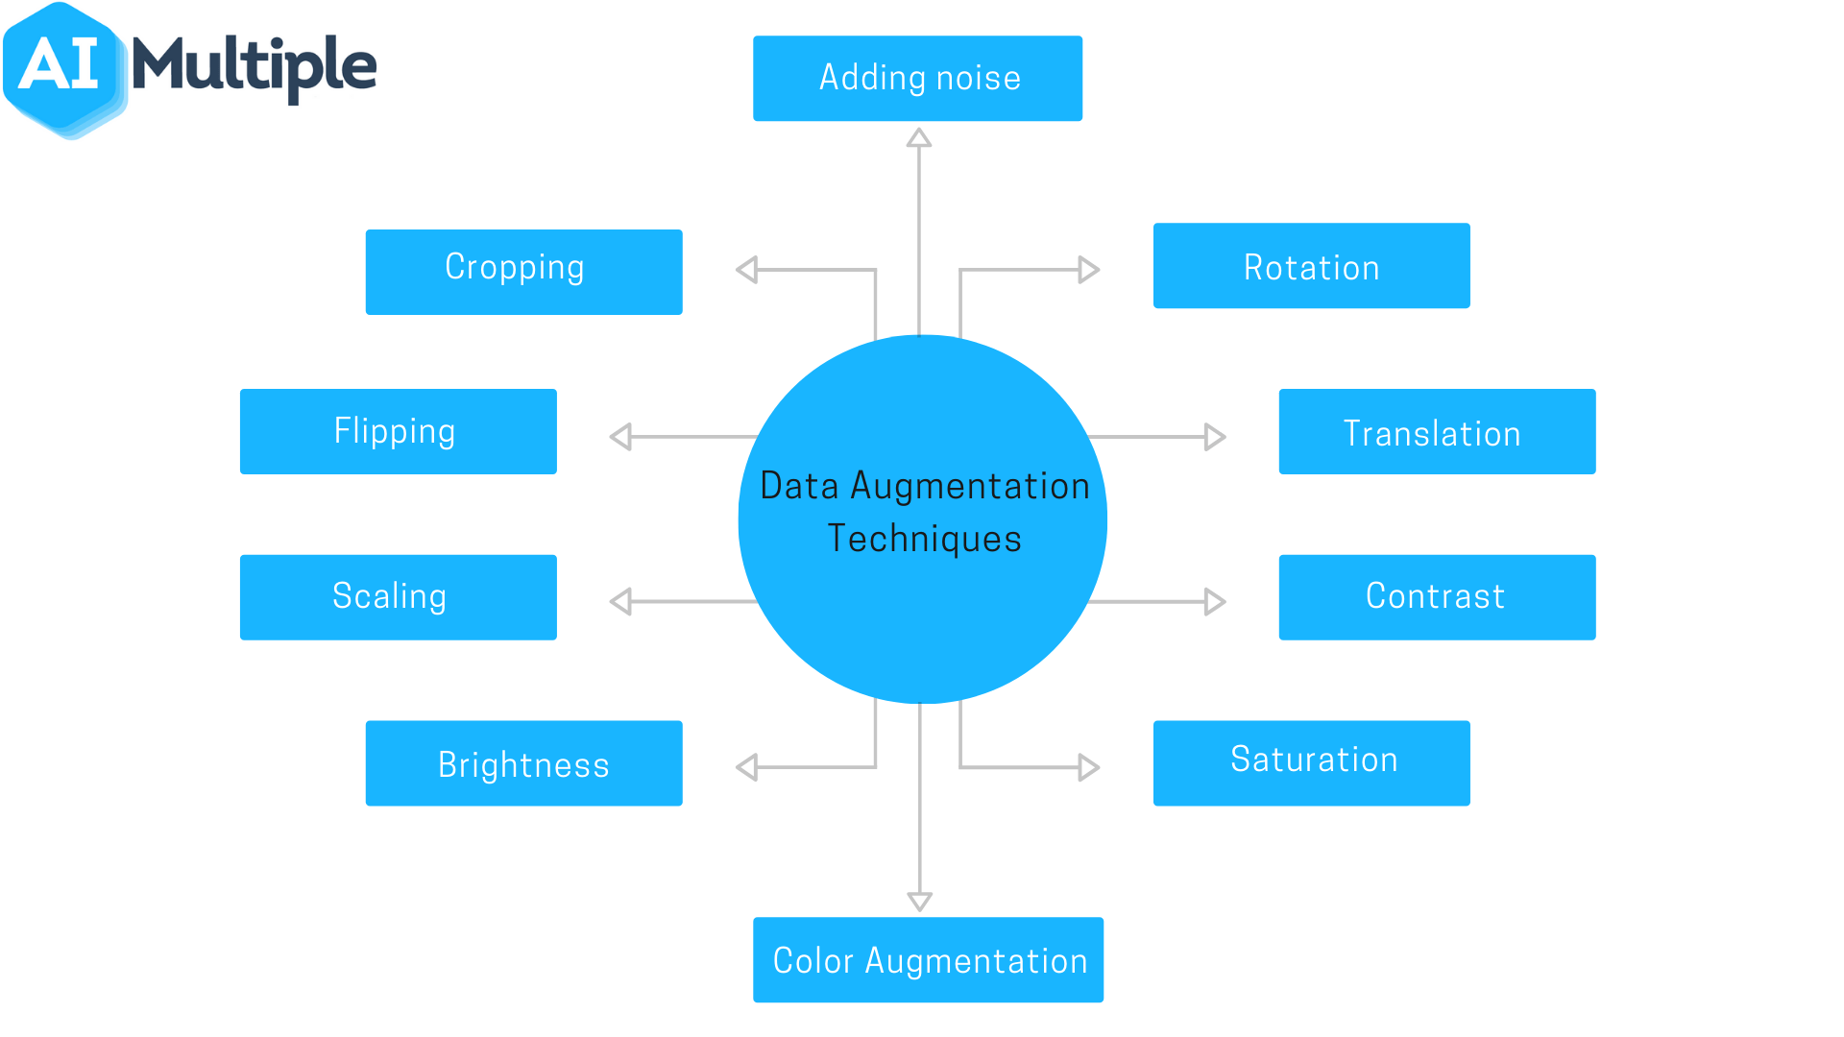
4. Pre-processing Techniques
4.6 Data Augmentation
Involves creating variations of the original images through methods like rotation, flipping, zooming, or cropping.
Use Case: Widely used in training deep learning models to improve the generalization of the model by simulating various transformations.

Slide 24
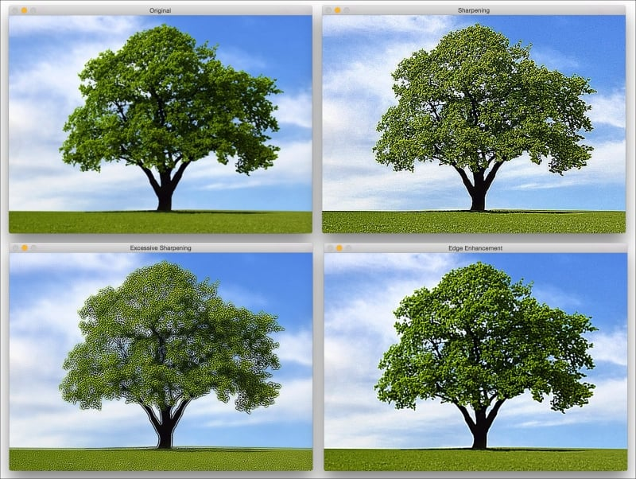
4. Pre-processing Techniques
4.7 Edge Enhancement
Amplifies the edges in an image to make features more distinct. Techniques like unsharp masking or high-pass filtering are used.
Use Case: Beneficial in applications where edge definition is critical, such as feature detection in engineering and manufacturing.

Slide 25
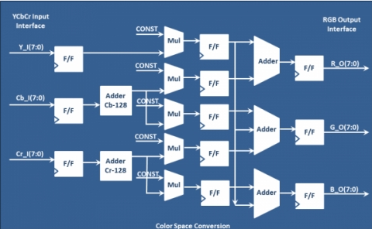
4. Pre-processing Techniques
4.8 Color Space Conversion
Changes the color representation of an image, for example, converting from RGB to HSV or YCbCr.
Use Case: Useful in color-based image processing tasks like color segmentation, object tracking, and skin tone detection.

Slide 26
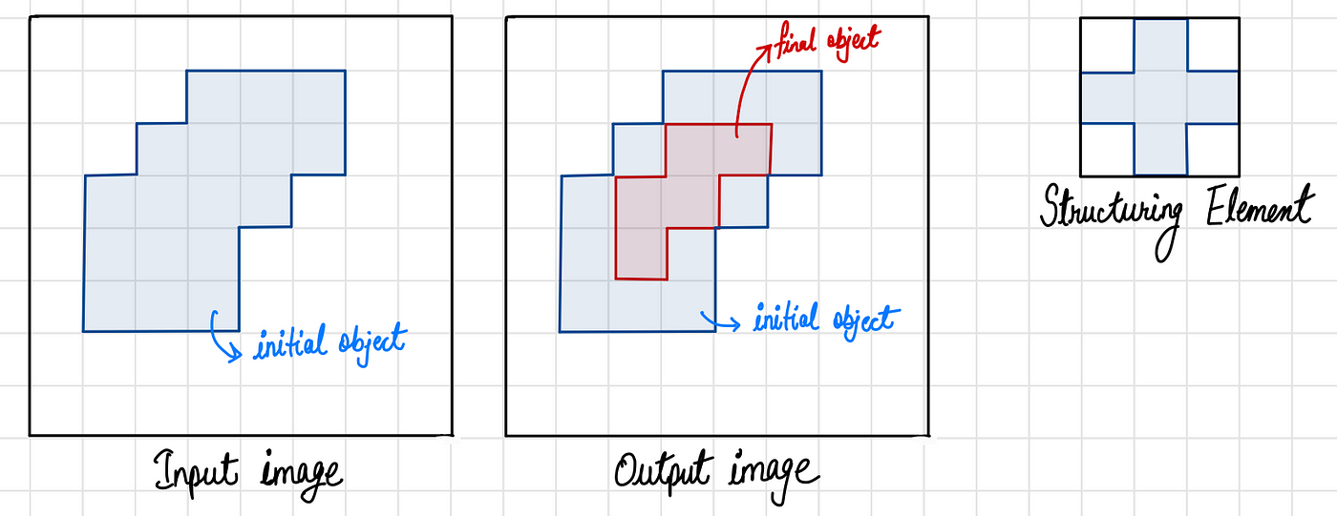
4. Pre-processing Techniques
4.9 Morphological Operations
Applies operations like dilation, erosion, opening, and closing to shape and structure within an image.
Use Case: Widely used in image segmentation, particularly useful in biomedical image analysis for separating or highlighting specific structures.

Slide 27
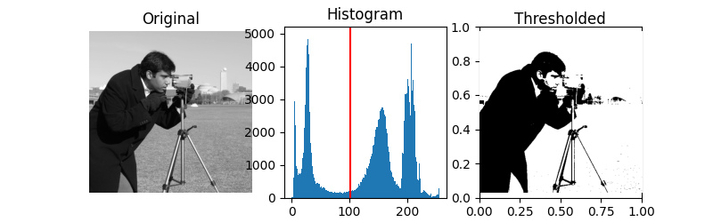
4. Pre-processing Techniques
4.10 Thresholding
Converts an image to a binary image, where pixels are marked as either foreground or background based on a threshold value.
Use Case: Commonly used in document scanning and OCR (Optical Character Recognition) applications.

Slide 28
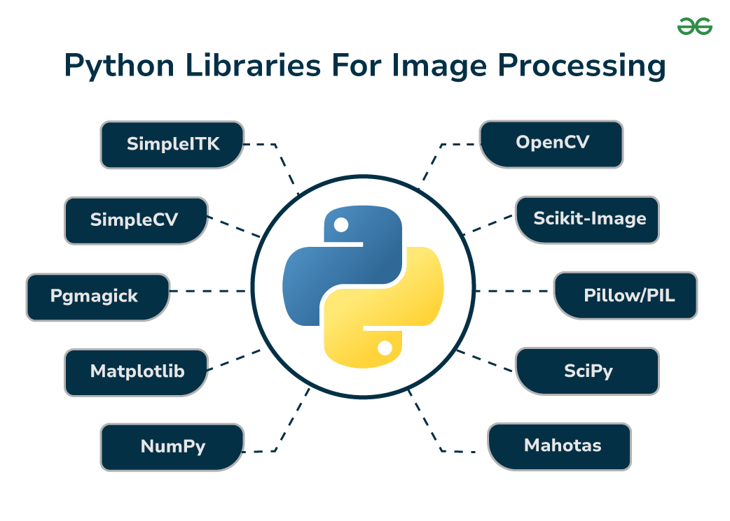

Slide 29
5. Conclusion and Future works
Conclusion:
Make it your own

Slide 30
5. Conclusion and Future works
Future works:
Make it your own

Slide 31
Thanks for your attentions!
Notes:
Link demo backup: https://drive.google.com/file/d/1ZTo4s2R087DQ3RH9yXV_LUSHPTXR-qWH/view?usp=sharing

Slide 32
References
Make it your own

